Slide 1

Incident Management Dashboard Visualization
By: Sami, Juan, and Israel

Slide 2
Tickets generation summary
The tickets were generated from following input parameters:
Number of tickets to generate: 10000
Time window start date: 2023-05-01
Time window end date: 2023-10-18
Observation on October Ticket Volume: note that since October is midway through, the average ticket volume for this month is anticipated to be lower when compared to the preceding months.

Slide 3
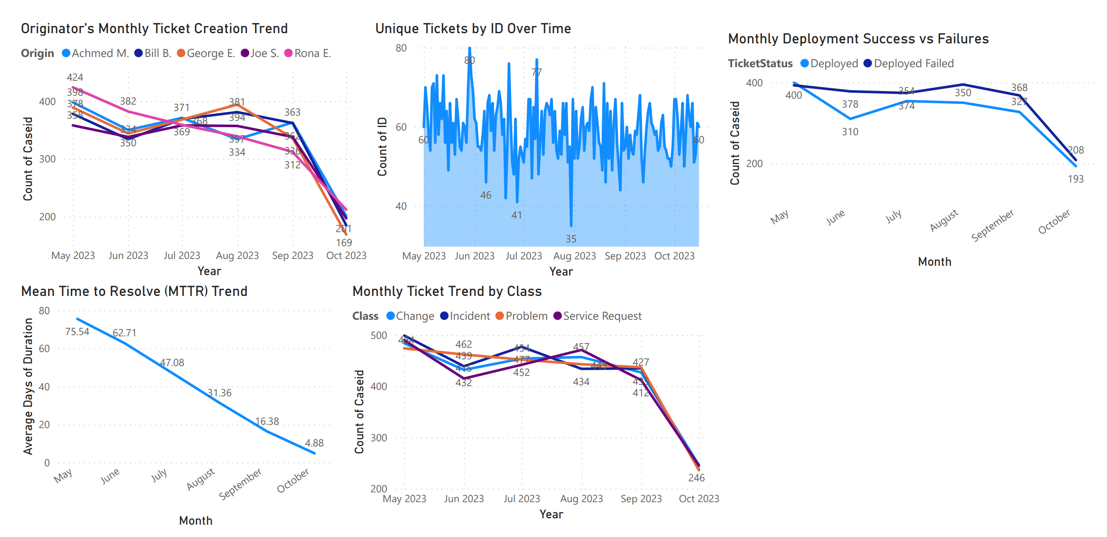
Full Dashboard

Slide 4
Monthly Ticket Trend by Class
This chart displays the monthly count of tickets for different classes from May to October 2023. Each line signifies a distinct ticket class, such as 'Change', 'Incident', 'Problem', and 'Service Request'. Across the period, variations in ticket counts can be observed for each class, with all classes experiencing a noticeable decrease in October. The visualization provides a snapshot of ticket dynamics within this sample dataset over the six-month period.

Slide 5
Monthly Ticket Trend by Class
Power BI Desktop
Class
500
Change Incident Problem Service Request
499
484
474
477
471
457
443
462
454
450
452
442
435
427
439
432
434
412
415
400
Count of Caseid
350
300
250
246
237
200
May 2023
Jun 2023
Jul 2023
Aug 2023
Sep 2023
Oct 2023
Year

Slide 6
Monthly Deployment Success vs Failures
The graph presents the monthly count of successful deployments versus failed deployments from May to October 2023. A clear trend can be observed, failed deployments are steadily higher than successful. Also the number of successful deployments and failed deployments generally maintains steady until the 4th quarter where they subsequently nose dive. This visualization provides a comparative overview of deployment outcomes within the sample dataset.

Slide 7
Monthly Deployment Success vs Failures
TicketStatus Deployed Deployed Failed
Power BI Desktop
400
400
393
395
378
374
354
368
350
350
327
Count of Caseid
310
300
250
200
208
193
May
June
July
August
September
October
Month

Slide 8
Mean Time to Resolve (MTTR) Trend
This visualization showcases the Mean Time to Resolve (MTTR) for tickets on a monthly basis from May to October 2023. The MTTR metric indicates the average duration required to resolve a ticket, and a downward slope suggests efficiency improvements over time. Throughout the period, there's a consistent decrease in MTTR, suggesting that resolution times for tickets have been improving in this sample dataset.

Slide 9
Mean Time to Resolve (MTTR) Trend
Power BI Desktop
80
75.54
62.71
60
Average Days of Duration
47.08
40
31.36
20
16.38
4.88
0
May
June
July
August
September
October
Month

Slide 10
Unique Tickets by ID Over Time
The chart depicts the count of unique tickets based on their ID for each day from May to October 2023. The daily variations are quite pronounced, with certain days experiencing significant spikes, while others have fewer unique tickets. This visualization helps in understanding the day-to-day fluctuation in ticket creation within the dataset.

Slide 11
Unique Tickets by ID Over Time
Power BI Desktop
80
80
76
77
71
70
69
67
66
67
60
Count of ID
60
60
50
48
47
49
46
44
40
42
41
35
Aug 2023
May 2023
Jun 2023
Jul 2023
Sep 2023
Oct 2023
Year

Slide 12
Originator's Monthly Ticket Creation Trend
The visualization represents the trend of ticket creations for different originators from May to October 2023. Each line represents an originator, and their respective monthly ticket creation counts are plotted. There are noticeable variations for each originator, with some showing a consistent decrease in tickets over time, while others fluctuate across the period. This chart offers insight into the ticketing patterns of different originators in the sample data.

Slide 13
Originator's Monthly Ticket Creation Trend
Origin Achmed M. Bill B. George E. Joe S.
450
Power BI Desktop
Rona E.
424
400
398
389
394
378
382
381
371
358
369
358
368
357
363
362
350
350
344
334
339
336
338
312
Count of Caseid
334
300
250
200
212
201
185
169
150
May 2023
Jun 2023
Jul 2023
Aug 2023
Sep 2023
Oct 2023
Year

